Slide 1




Pilot Study on the Efficacy and Feasibility of Streamlined Cognitive Behavioral Therapy for Depression
Naoki Takamatsu

Slide 2
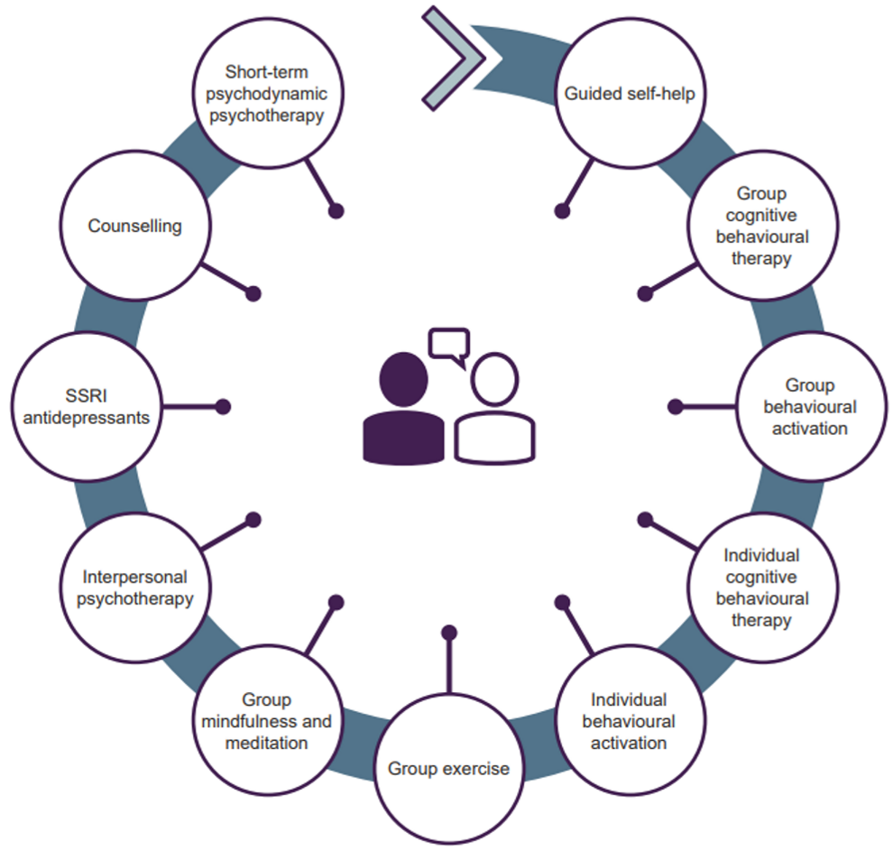
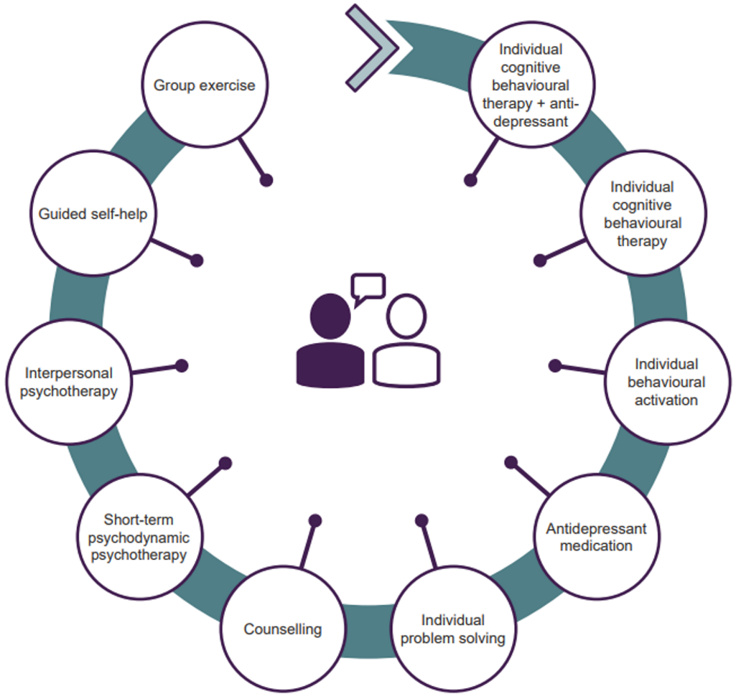
Background
Less severe depression
More severe depression
Evidence of CBT for depression
NICE Guideline, 2022

Slide 3
Low intensity
High intensity
Internet CBT
Group CBT
Individual CBT
Streamlined CBT (SCBT)
SCBT: High intensity 1-to-1 session

Slide 4
 | Japan (n = 42) | United States (n = 39)
Age (yrs) | 34.0 | 32.5
PGY (yrs) | 6.9 | 3.3
# Patient visits (/day) | 32.7 | 4.4
Visit length (min) | 8.3 | 36.1
Appointment length <10 min in Japan
Japanese Ministry of Health Labour and Welfare, 2016
Notes:
mean duration of psychiatric outpatient visits
length of psychiatric office-based outpatient visits
average durations of mental health visits
Psychiatry appointment
Average visit length with psychiatrists

Slide 5

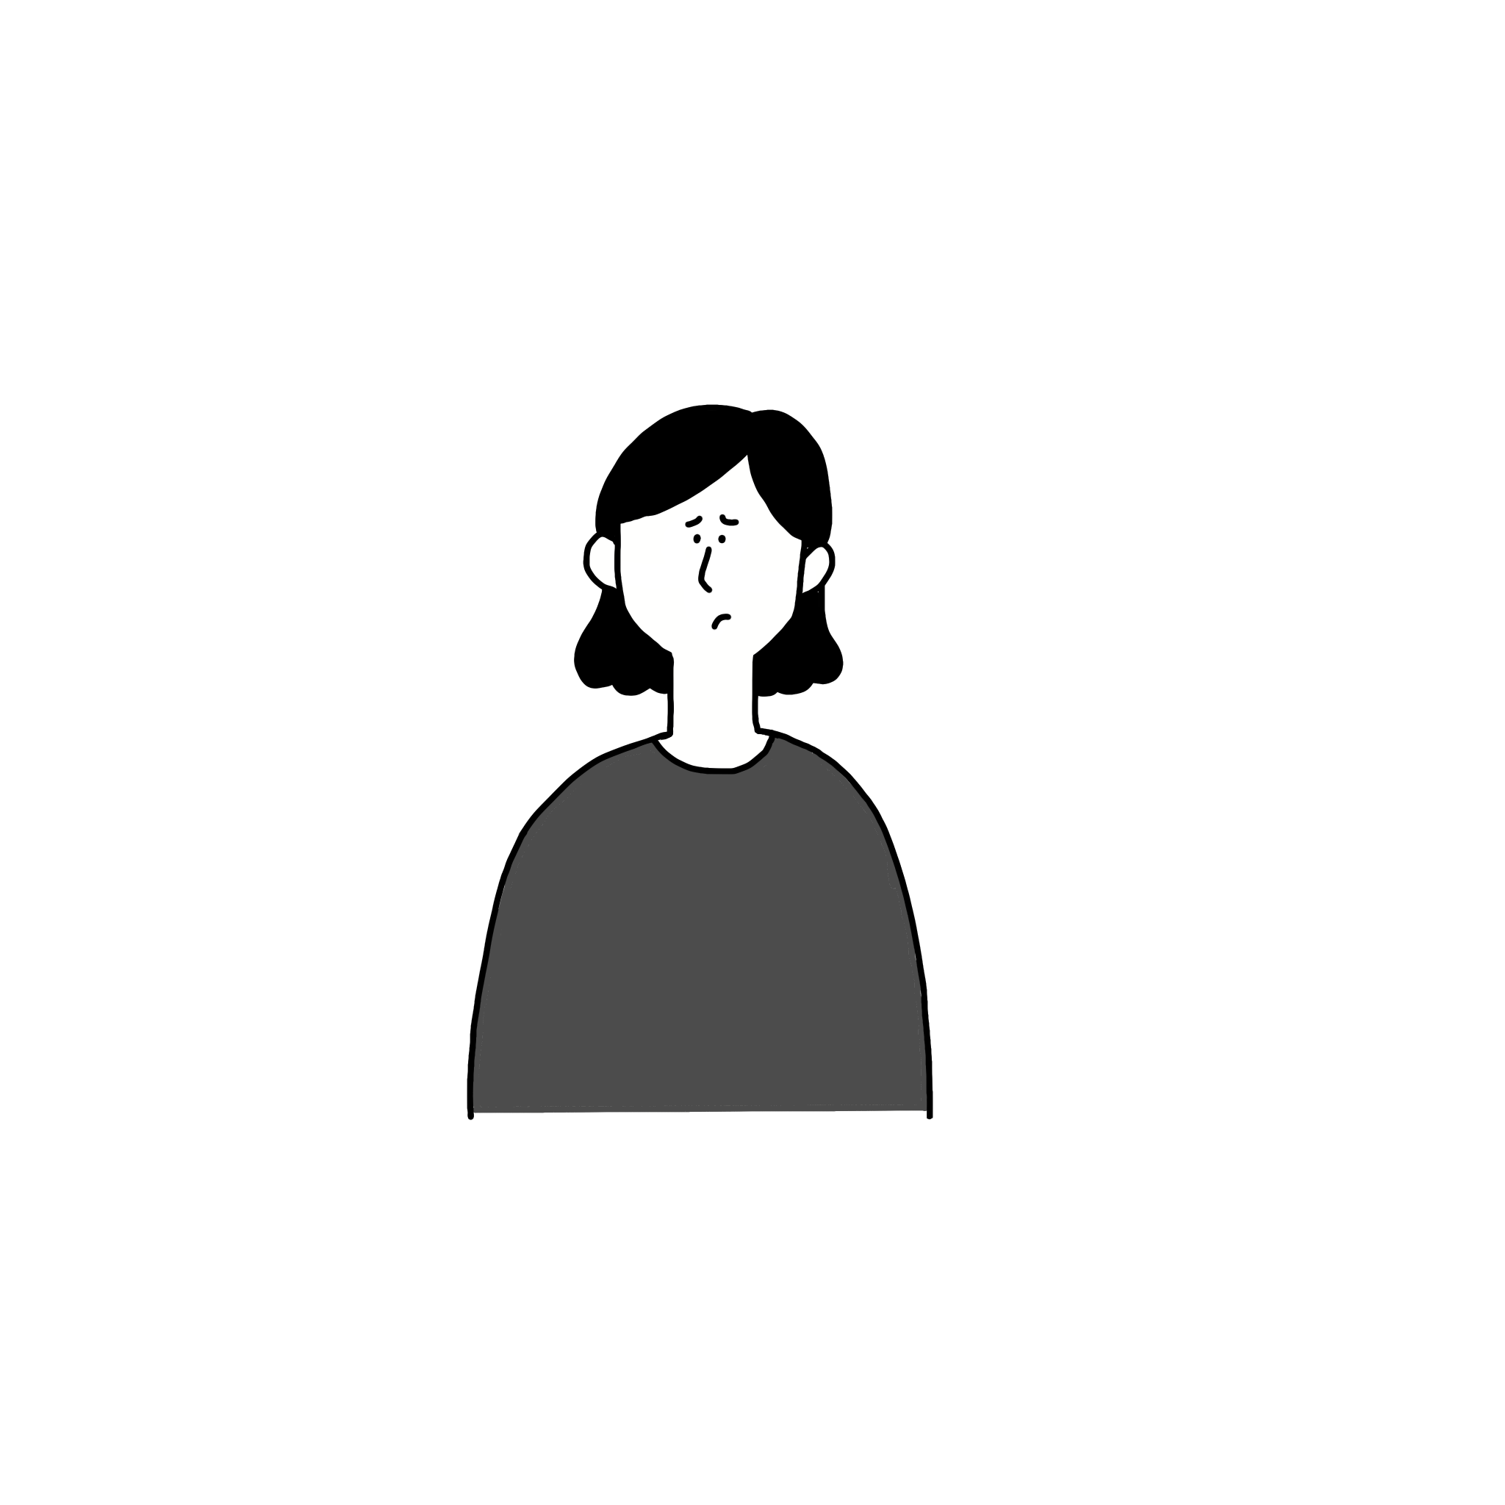
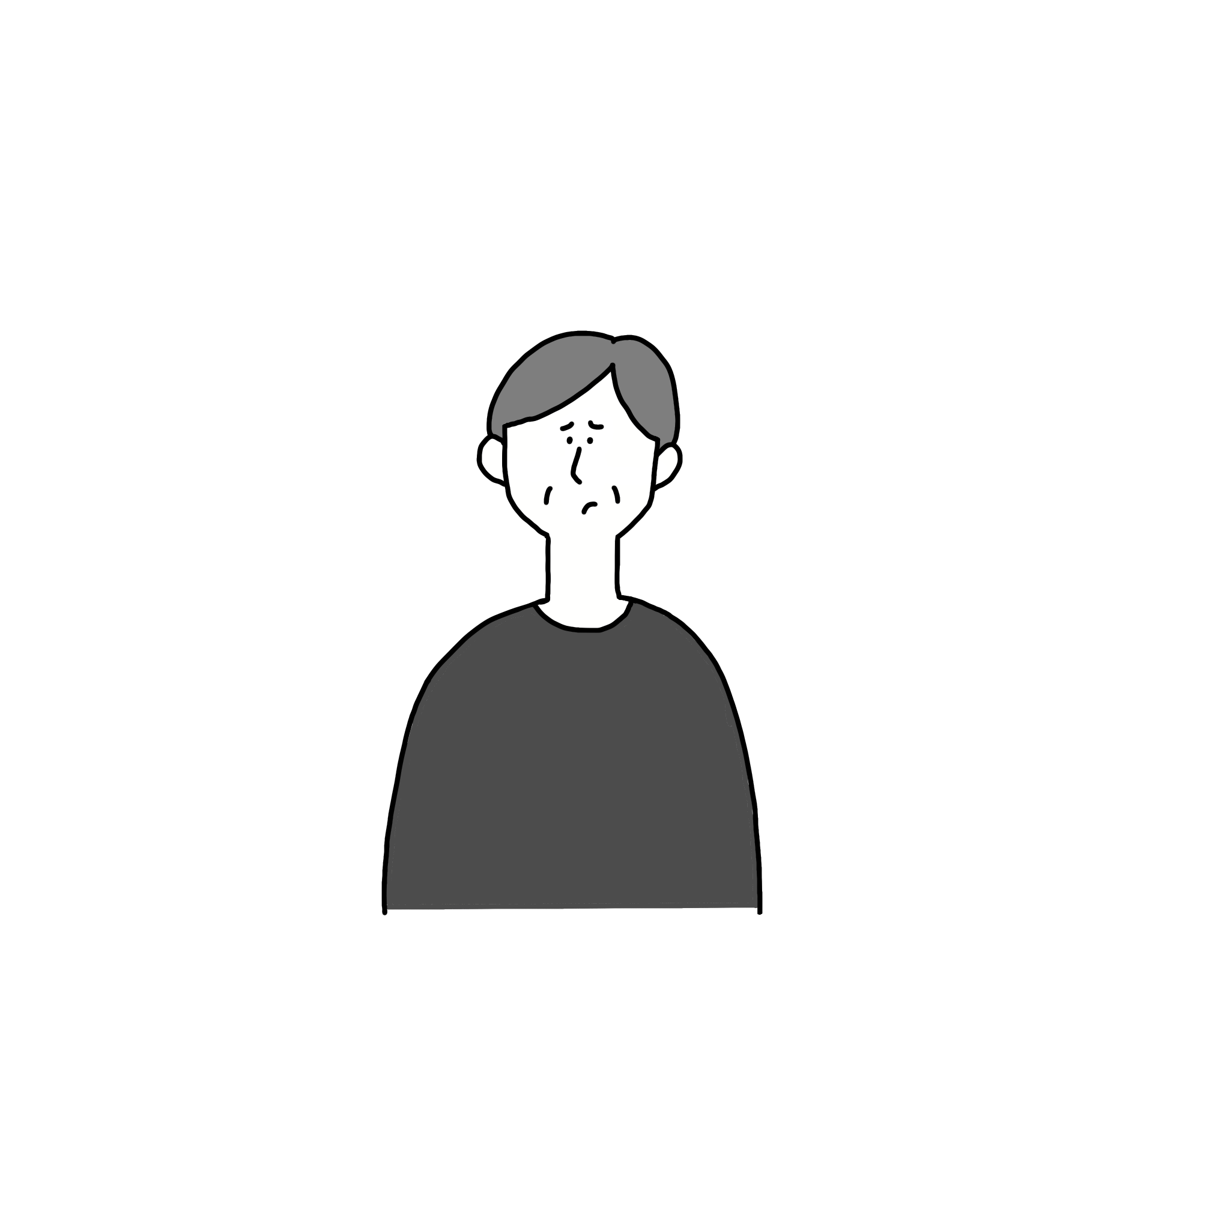
High demands from other fields
1600
Time-consuming
50-minute session x16 sessions
# of CBT providers*
1.3 million
# of patients*²
*Those who finished individual CBT training (2011-2020)
*²Annual prevalence of depression
Exceeding demands in providing CBT

Slide 6


Purpose
Develop shorter and more efficient CBT
Less time burden/constraint
II
More availability
More Performable
II
More therapists
Dissemination and social implementation of CBT

Slide 7
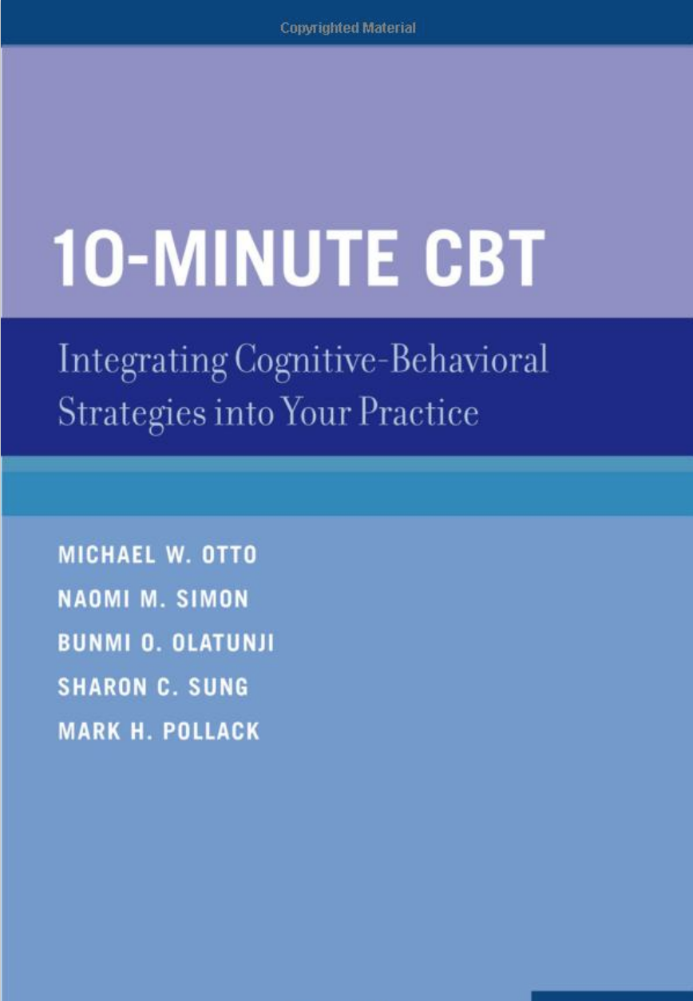

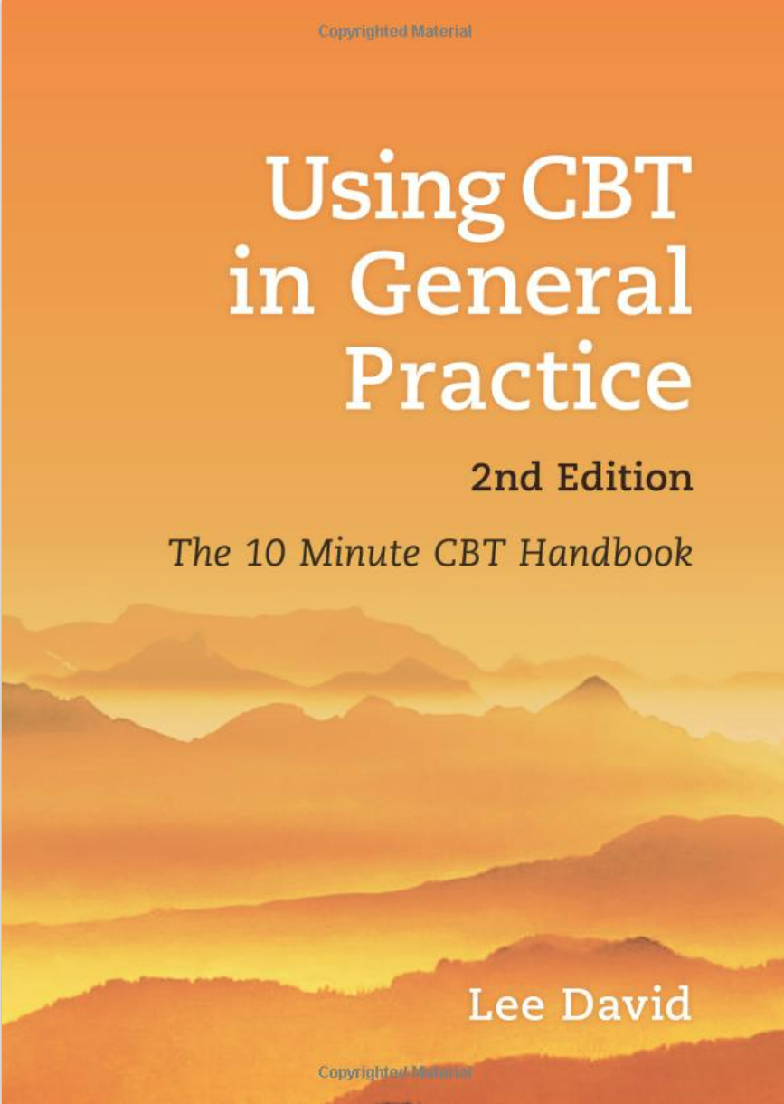



Method
日本語訳
Coming soon
Psychologist
Psychiatrist
GP
Multidisciplinary practice providing CBT overseas

Slide 8
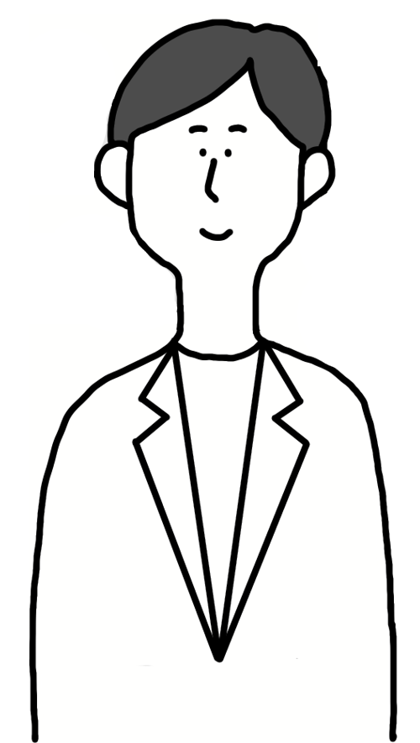
Therapist
Patient
Easier and efficient way to:
Set an agenda
Formulate a case
Explain skills/techniques
Access to resources for:
Self-management training
Self-help
Notes:
less time-consuming way to perform session.
Access to resources outside of session for self-training and treatment

Slide 9
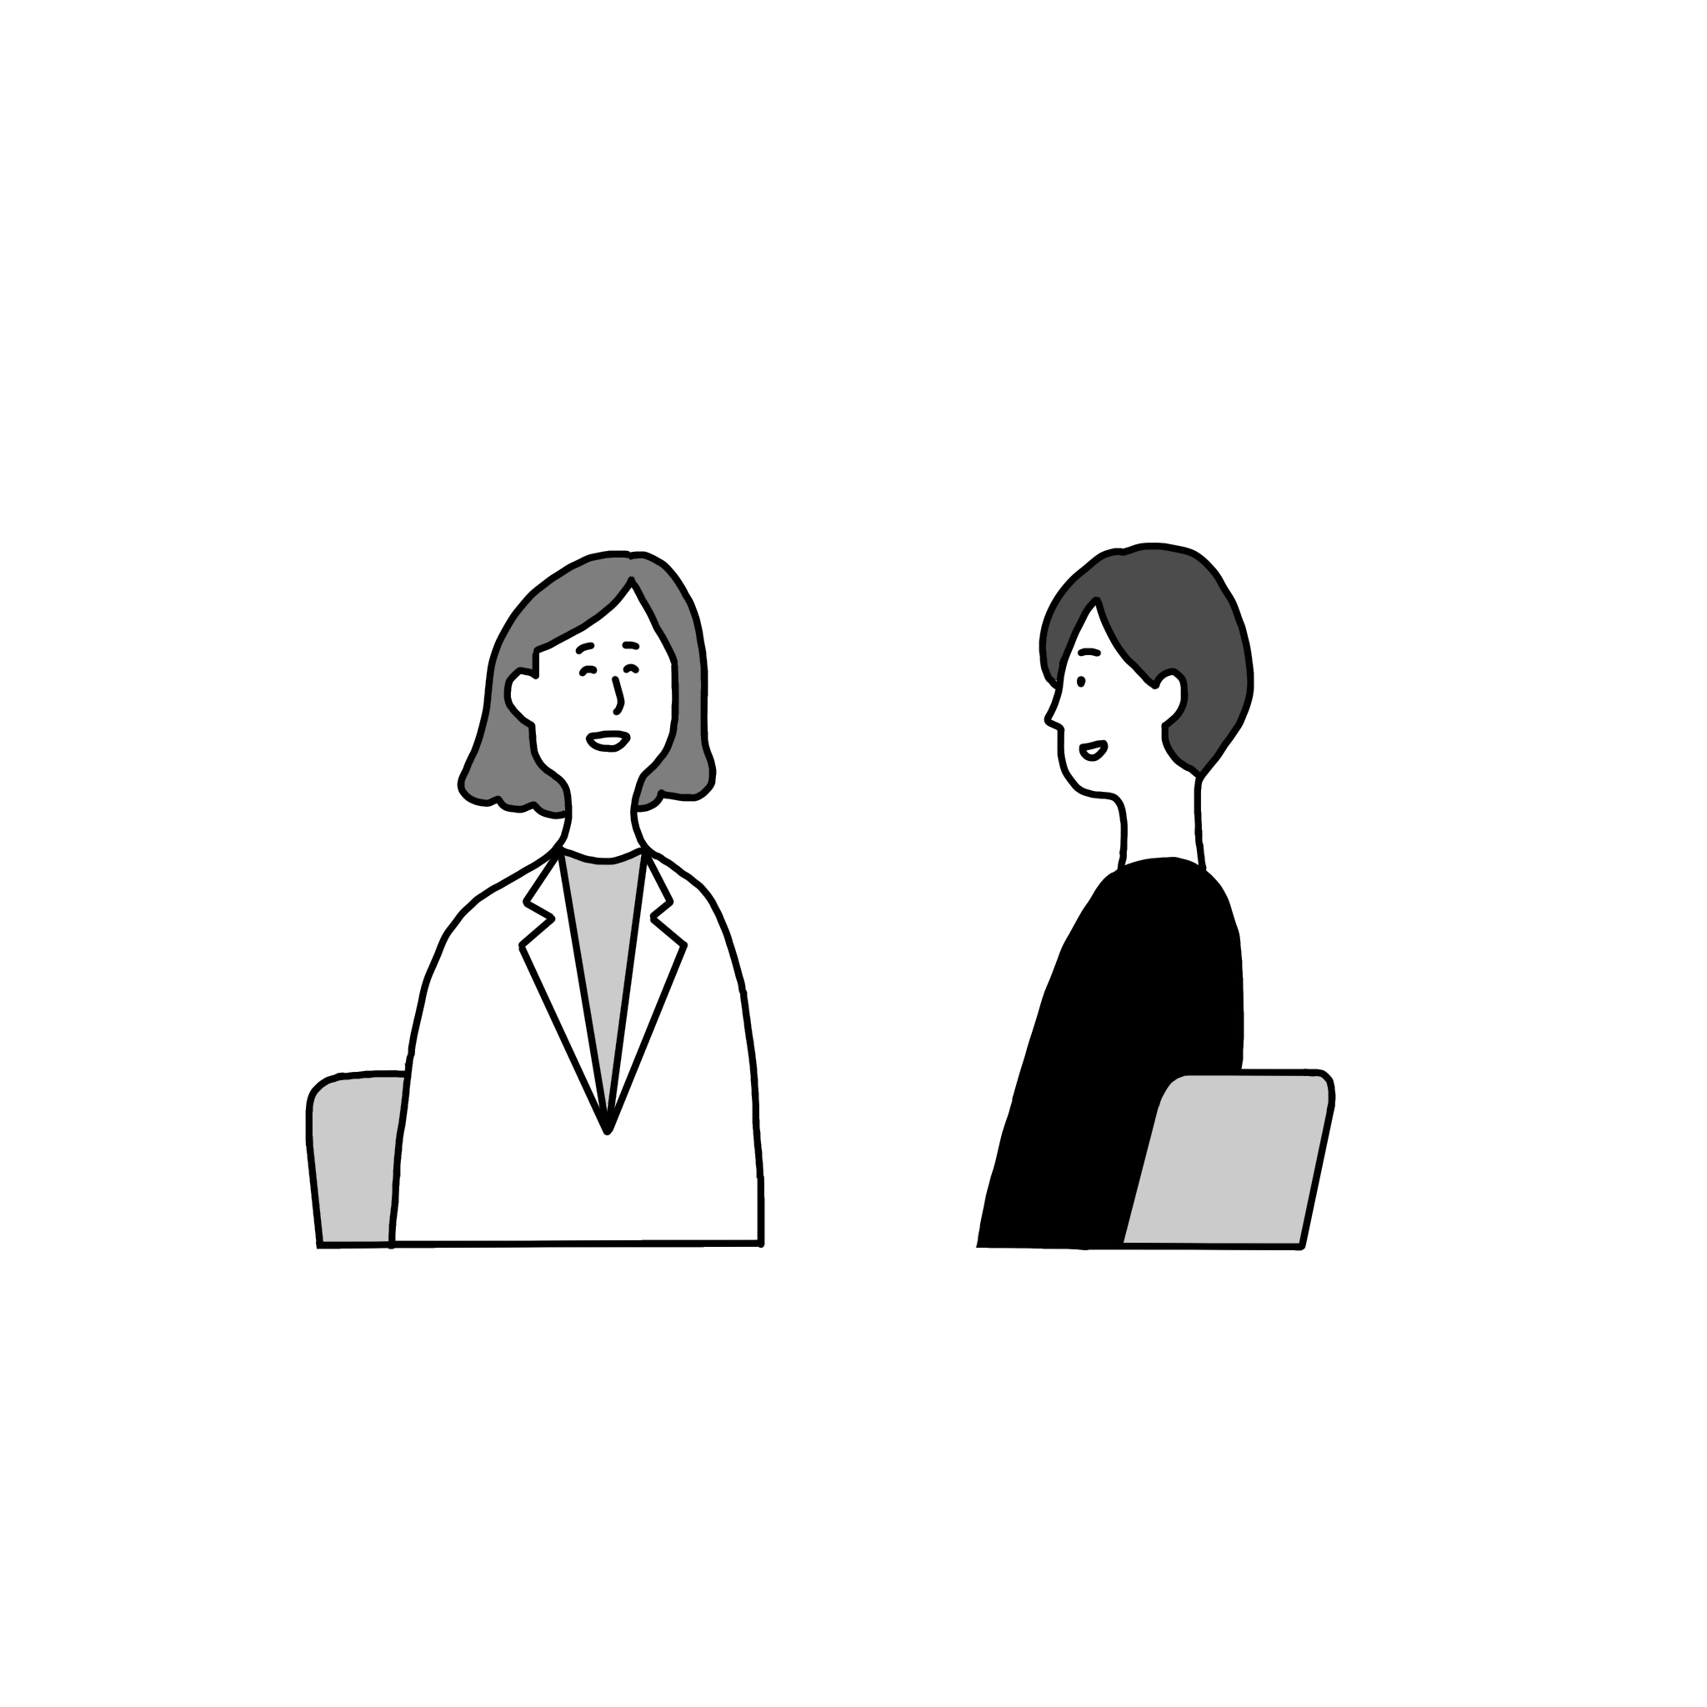

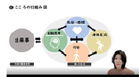
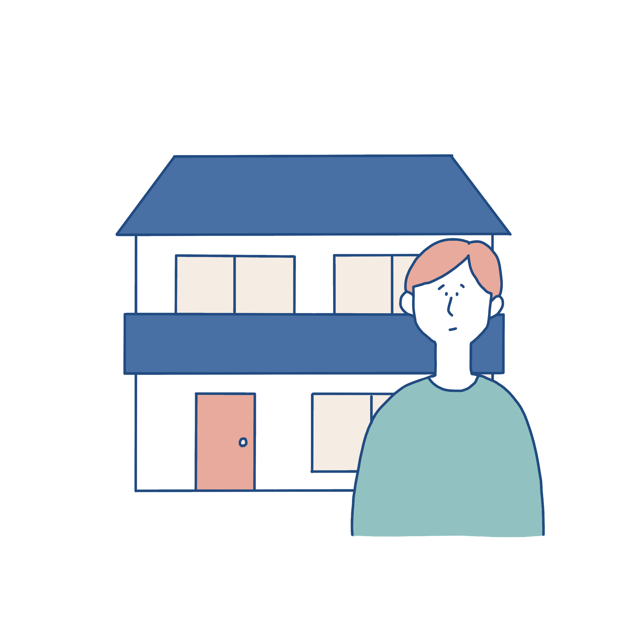
Results
15-minute
session
In between
sessions
Hospital
Home
“Opening” sheet
“End” sheet
Case formulation sheet
Educational online materials
Available anytime anywhere
Notes:
そこで、効率型認知行動療法、SCBT(Streamlined CBT)をいうものを開発していて、診察室では15分、そしてセッションとセッションの間に患者さんが動画を見たり、ワークに取り組んだりして、通常の認知行動療法と比較してもそんたくのない効果を目指しています。

Slide 10
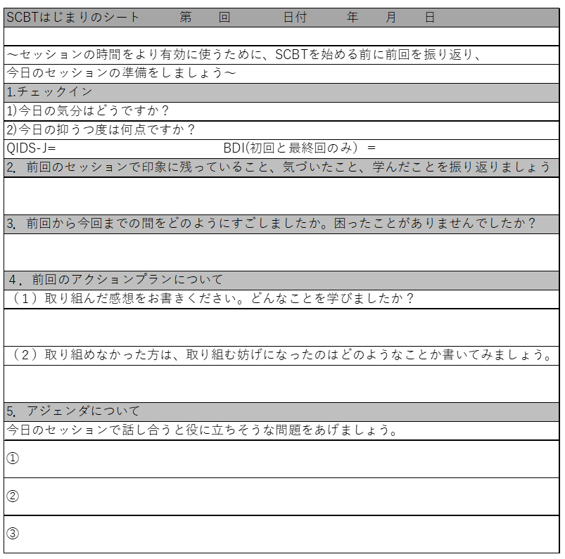
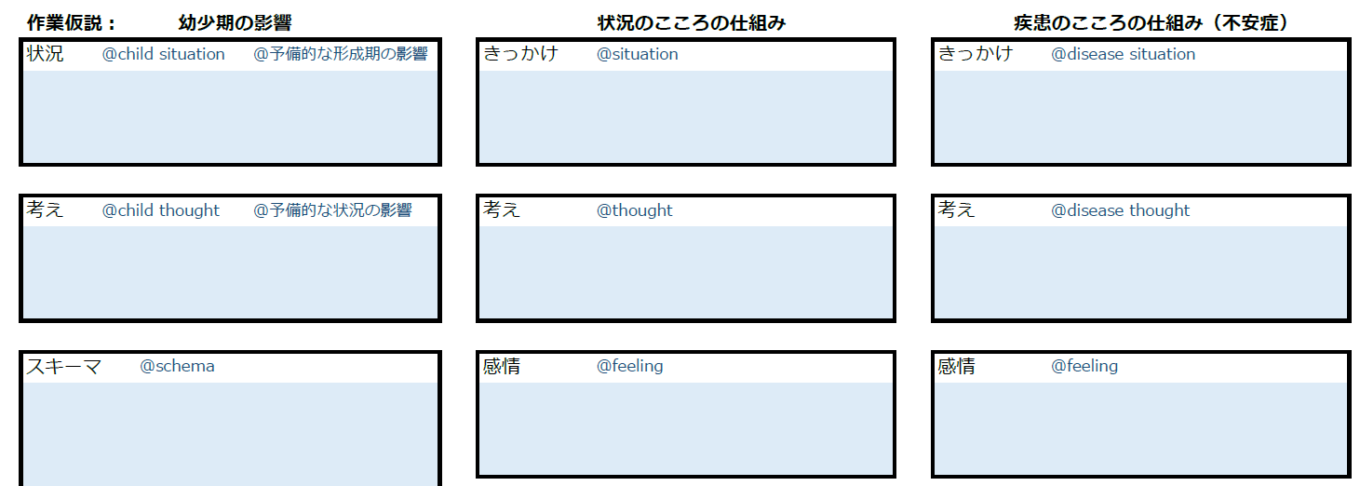
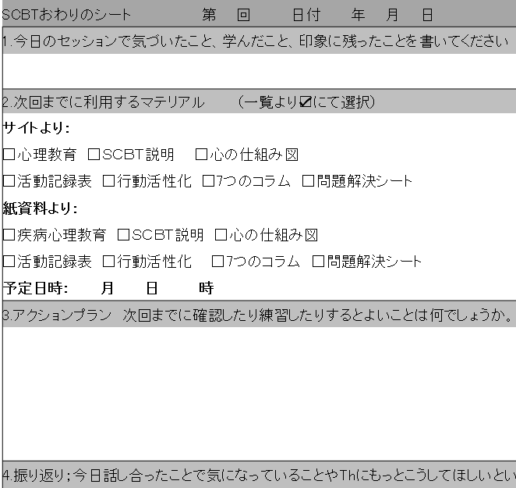
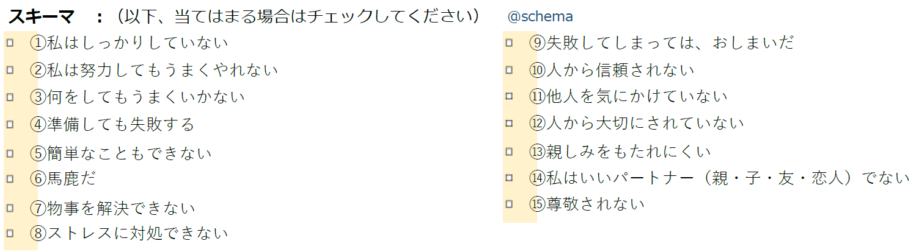
Situation / Thoughts / Feelings
(From childhood to current experiences)
New discoveries/thoughts
Materials to utilize
Agenda / Action Plan
Typical Schemas / Core beliefs
(Seen in depression)
Opening Sheet End Sheet
Case Formulation Sheet
Materials to enhance efficiency throughout CBT session
Notes:
Efficient agenda setting and action plan
. Understanding patient in a shorter time period

Slide 11
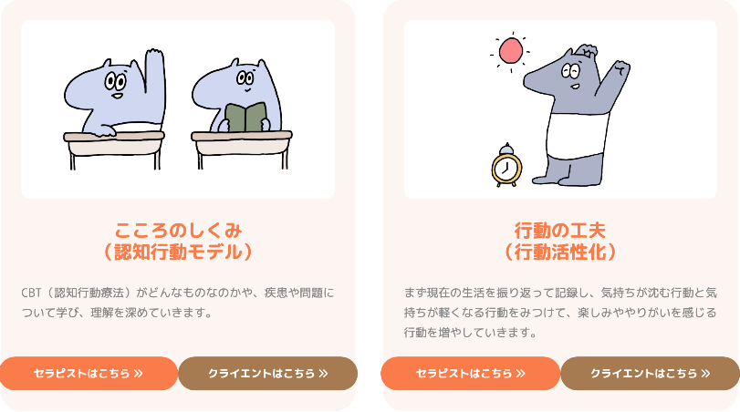
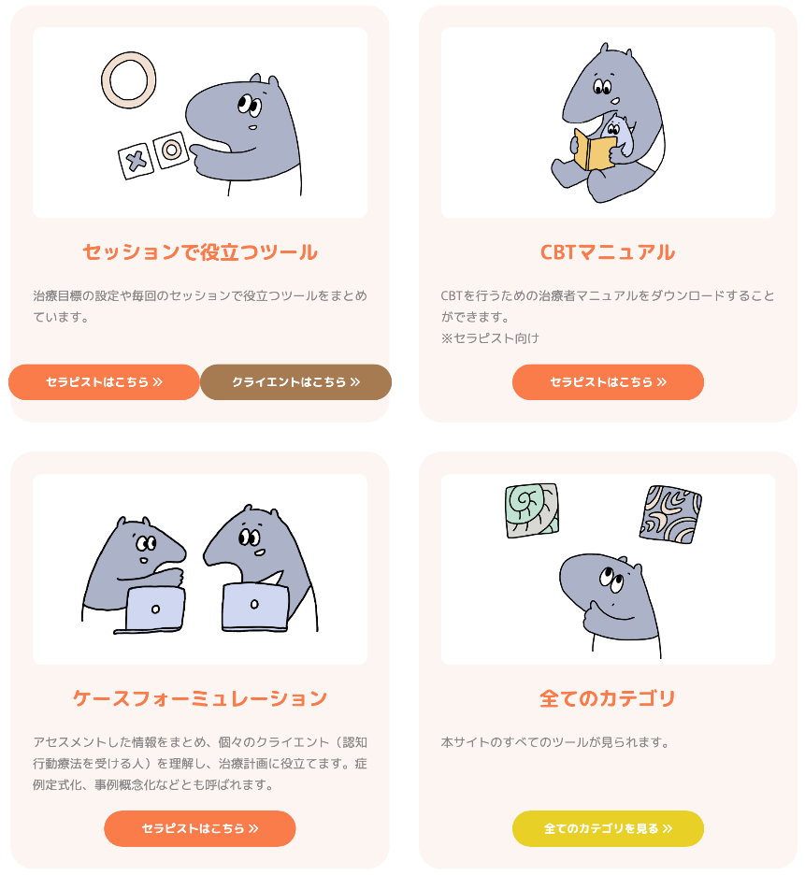
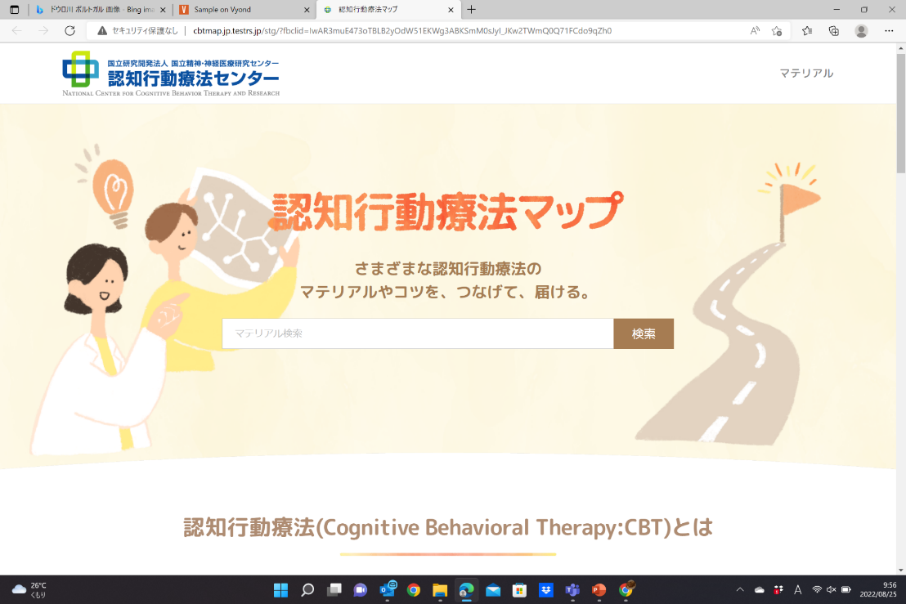
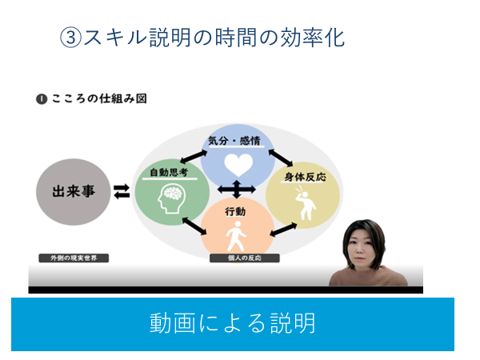
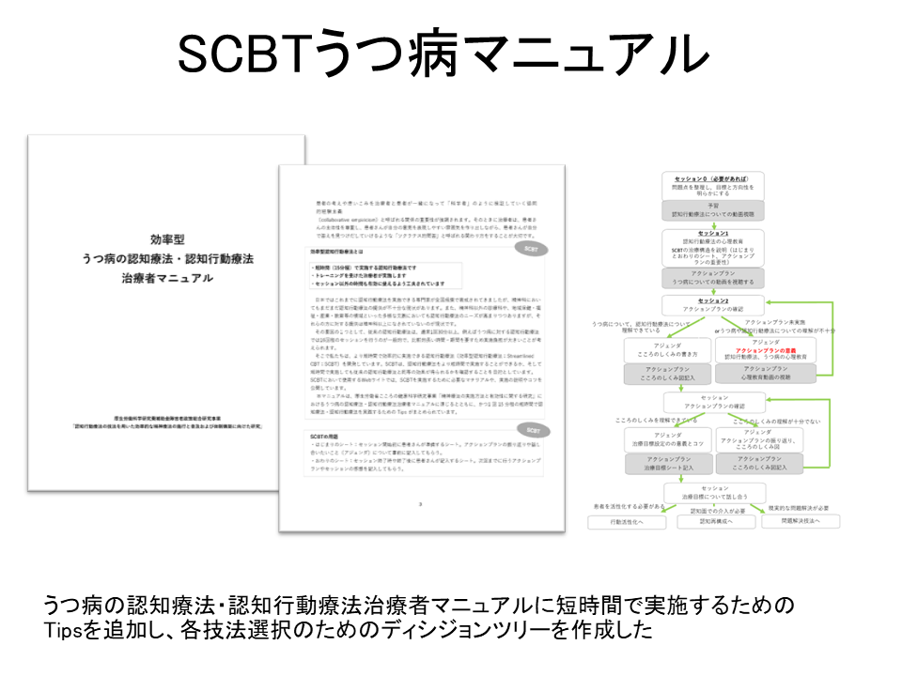
Cognitive model
Behavioral
Activation
CBT Manual
Helpful tools during CBT sessions
CBT Map
Open online resources
On-demand videos
Easy-to-follow charts
At-Home therapy experience and guided help
Notes:
Shortening time for skills and CBT techniques
At home therapy experience and guided help

Slide 12
CBT | Allotted time |  | SCBT
Self-report questionnaire (BDI) |  |  | Fill in Opening Sheet
Check-in | 10 min | 5 min | Review Opening Sheet
Review homework |  |  | Discuss hindering issues
Agenda setting |  |  | Agenda setting
Discuss CBT techniques | 35 min | 7 min | Discuss CBT techniques
Action Plan setting | 5 min | 3 min | Action Plan setting Introduce relevant online materials
 |  |  | Fill in End sheet
SCBT structural differences and characterization
Notes:
self-report questionnaires

Slide 13
Discussion
CBT
SCBT
Situation
Emotions
Automatic thoughts
Supporting evidence
Contrary evidence
Adaptive thoughts
Outcome
Situation
Emotions
Automatic thoughts
Adaptive thoughts
Outcome
Action plan
ANTs
Introducing the 6-column thought record
Notes:
Helpful Action

Slide 14
Feasibility Study
5/12 currently enrolled
Clinical Question
Patient | 12 Adult patients with more than moderate depression
Intervention | SCBT
Comparison | Treatment as usual
Outcome | Depressive symptoms measured by QIDS-J (+ pre/post neuroimaging)
Timing | 15-minute session x16 visits
Completion of study by end of FY2022, Planning for future RCT

Slide 15


Concluding Remarks
❐ Developed a novel individual CBT program
➡ Enables a 15-minute session
❐ Pilot study underway
➡ Checking efficacy and feasibility
Hopefully for further dissemination and
social implementation of CBT in Japan
Naokitakamatsu@ncnp.go.jp
Notes:
【意義】
通常のCBTの実施負担や臨床現場の普及の限界を鑑みると、医師や看護師、公認心理師等の多職種が患者に対し適切な見立てに基づき限られた時間の中でも、効率的にCBTを提供できるようになれば、国内のCBTの普及および均てん化につながり、高い医療経済効果が期待される。
本研究をSCBTのフィージビリティを確認するにとどめず、今後実施するランダム化比較試験の前段階と位置付け、MRI撮像の環境整備、撮像から解析までのパイプライン整備、RCTに向けた体制づくりなどを進めることで、次段階で有効性を確認し、SCBTの普及と実装により、必要な人に必要な治療を届けることに貢献することができる。
また、近年脳機能イメージングアプローチによりCBTの治療機序の解明を目指す研究が蓄積され、関連する神経基盤が示唆されているものの、一定のコンセンサスには至っていない。本研究及び次段階の研究において、SCBTの実施前後と後観察における脳画像撮像により、脳の構造的・機能的所見及びその変化を明らかとすることで、生理学的エビデンスからSCBTの有効性を評価でき、治療機序の解明、治療の反応性、治療効果予測に繋がると考える。

